Slide 1
G2T16
Improving business efficiency in Animal Welfare Organisations
Arino Ang
Darren Ng
Kin Chia Heng
Nor Aisyah
Neo Jia Ying
Wong Wei Ling

Slide 2
TABLE OF CONTENTS
01
02
03
04
05
OUR CLIENT
BUSINESS
PROBLEMS
DATA
ANALYSES
INSIGHTS

Slide 3
OUR CLIENT

Slide 4

SPCA
Largest Non-profit animal welfare organisation in Singapore
Registered animal welfare charity with IPC status

Slide 5
BUSINESS PROBLEM

Slide 6
BUSINESS PROBLEMS
Lack in adoption of lost animals at SPCA
Low social media presence
Difficulty in pinpointing locations of stray/lost animal sightings resulting in SPCA taking a more reactive approach in locating them
Lack of understanding in public sentiments about SPCA as an animal welfare organisation

Slide 7
DATA

Slide 8


DATA
Hashtags Hashtags
Tweets Captions
Favourites
Retweets

Slide 9
ANALYSES

Slide 10
ANALYSES
TOPIC MODELLING
TEXT ANALYSIS
SENTIMENT ANALYSIS
Understand and sort keywords regarding our topic.
When and What to post on Social Media.
Determine if posts are generally positive/negative
NETWORK ANALYSIS
LOCATION ANALYSIS
Gather related #hashtags SPCA uses
Identify clusters/areas in SG that consist of lost animals

Slide 11
INSIGHTS

Slide 12
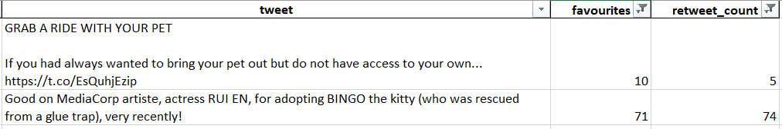
TEXT ANALYSIS
Tweets that received the most likes and retweets are tweets with:
Local celebrities being mentioned like Rui En
Companies such as Grab

Slide 13
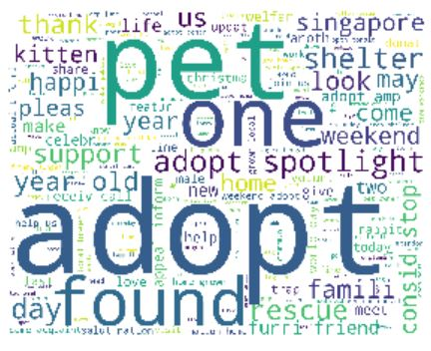
TEXT ANALYSIS
Tweets with the following words received favourites and retweets:
Pet
Adopt
Found
Rescue
Shelter

Slide 14
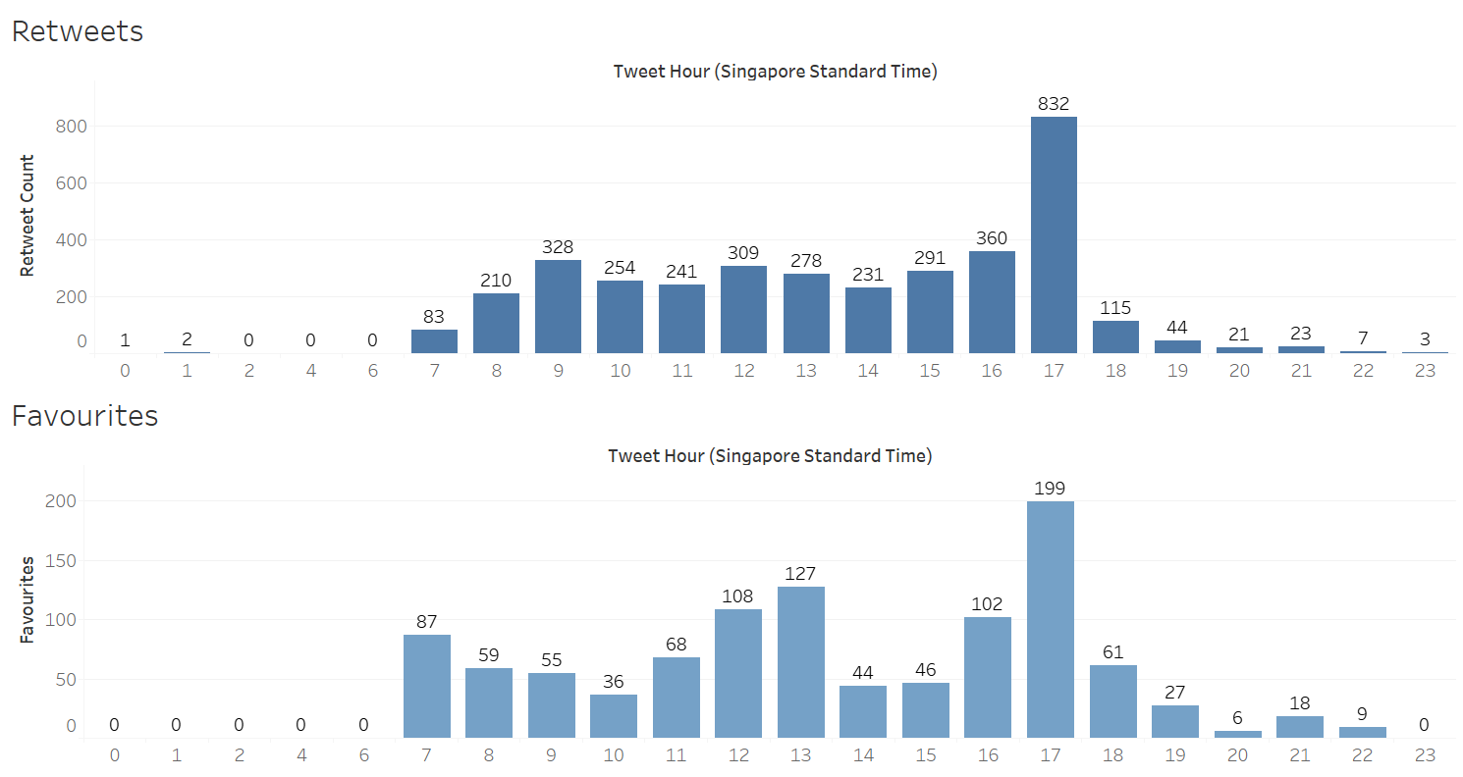
TEXT ANALYSIS
Notes:
Based on number of retweets and favourites, 5pm is the most optimal time to tweet

Slide 15
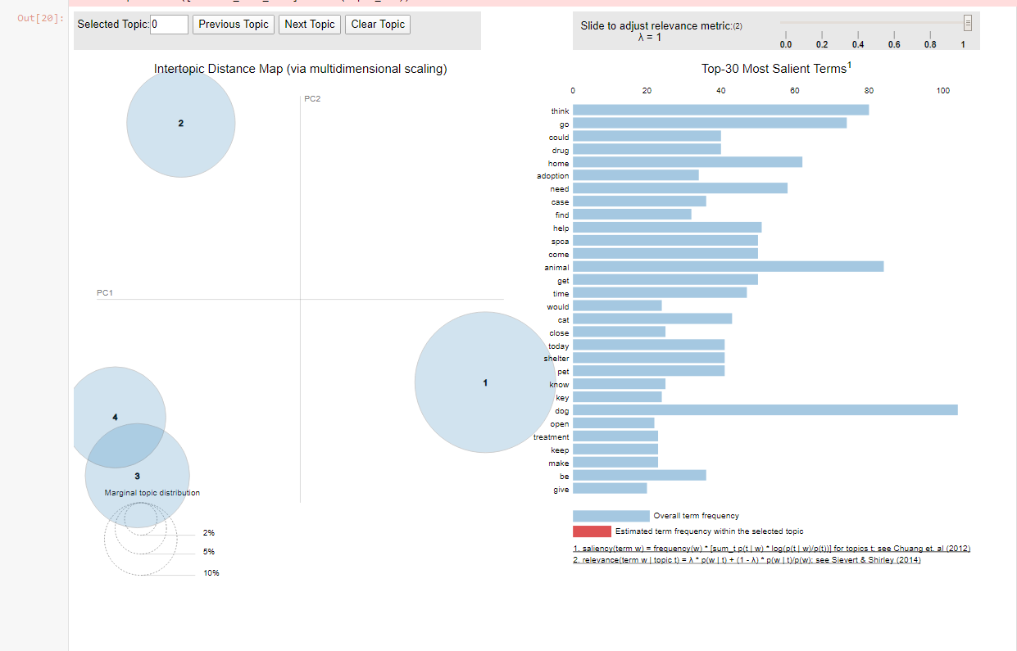
TOPIC MODELLING
Twitter:
Topic 1 : Animals looking to get adopted with words such as “home”, “adopt” and “foster”
Topic 2 : Medical aspect of animal welfare with words such as “case”, “drug” and “treatment”

Slide 16
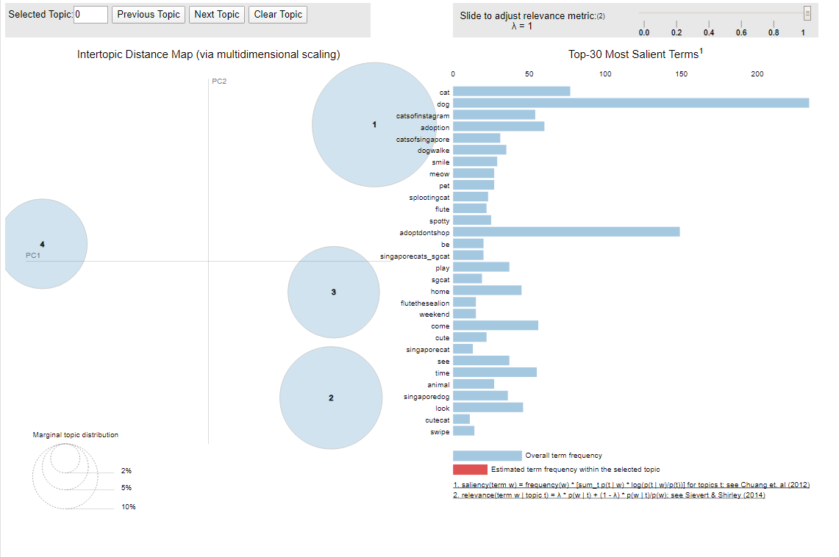
TOPIC MODELLING
Instagram:
Topic 1: Having dogs as pets with words like “dog”, “friend” and “support”.
Topic 2 and Topic 3: Adoptions of shelter animals with words like “adoptdontshop” and “adoption”
Topic 4: About cats with words such as “cat”, “catsofinstagram” and “catsofsingapore”

Slide 17
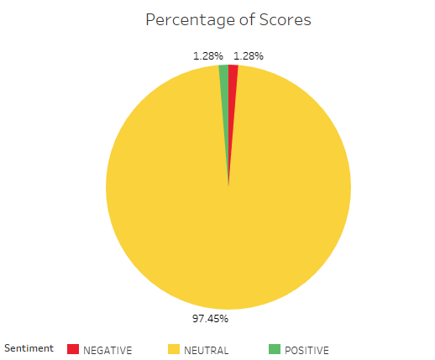
SENTIMENT ANALYSIS
Overall sentiment: Neutral
Low percentage of:
Positive & Negative
Notes:
For sentiment analysis, we manage to obtain a total of 235 tweets from Twitter using the hashtags “#spca_sg , #spca-sg and #animalabusesg”. Majority of the tweets scraped had a neutral sentiment with a high percentage of 97.45% whereas tweets of positive and negative sentiments had the same percentage of 1.28%.
It is also observed that tweets with neutral sentiment mostly consisted of retweets. Most positive tweets scraped are about rescuing stray animals and most negative tweets are about animal abuse.

Slide 18
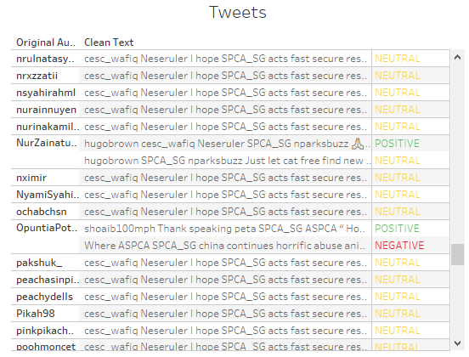
SENTIMENT ANALYSIS
Positive tweets: “rescue”
Negative tweets: “abuse”
Notes:
From the above analysis, we can assume that people who retweeted tweets generally have the same sentiments towards SPCA as the user of the original tweet. We can also conclude that generally, people are neither unhappy or happy when talking about SPCA. Thus, if SPCA wants to use this information and improve more on their image, they can focus more on rescuing animals to have more positive impact on their social media presence.

Slide 19
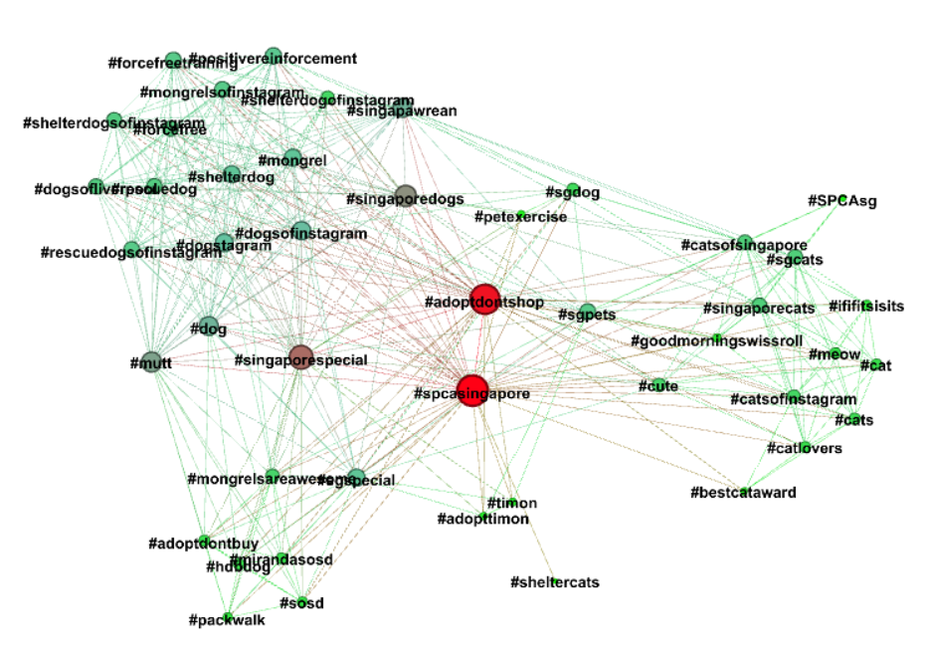
NETWORK ANALYSIS
Network graph of hashtags related to SPCA singapore
Top ranked hashtags in terms of degree centrality:
#spcasingapore
#adoptdontshop
#adoptdontshop has high betweenness centrality
Broker for cat and dog communities

Slide 20
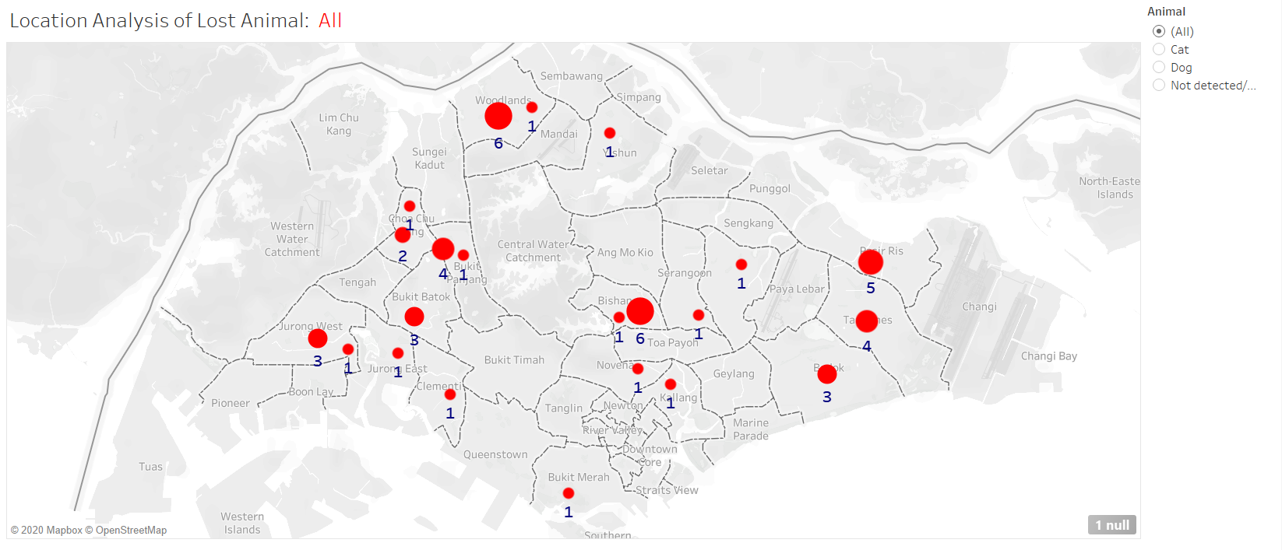
LOCATION ANALYSIS
Notes:
Based on number of retweets and favourites, 5pm is the most optimal time to tweet

Slide 21
LOCATION ANALYSIS
Most of the lost animals are found in the extreme east side of Singapore (Pasir Ris, Tampines, and Bedok).
East side is a popular and convenient place for people to hold pet owner meetups.
Smaller cluster of lost animals in Bishan and Woodlands.

Slide 22
RECOMMENDATIONS

Slide 23
TEXT ANALYSIS
SPCA should collaborate with celebrities and well-known companies to increase their social media presence
SPCA should use words like “Pet”, “Adopt”, “Found”, “Rescue”, “Shelter” when posting tweets
Based on the most number of likes and retweets, 5pm is the most optimal time to tweet

Slide 24
TOPIC MODELING
Twitter
SPCA can publicise their actions towards cases of sick shelter animals or stray animals in order to improve their image on social media.
SPCA could also try to assist those in need of financial assistance to bring their pet to the vet.

Slide 25
TOPIC MODELING
Instagram
Cat community in singapore is more active on instagram
SPCA should post more cat related posts on Instagram rather on other platforms as it appeals to the cat community who are mostly on this platform

Slide 26
SENTIMENT ANALYSIS
To increase SPCA’s overall sentiment to “Positive”:
Focus on rescuing animals
Share more posts on their rescued animals
Track negative tweets and act on it

Slide 27
NETWORK ANALYSIS
Currently, SPCA only uses their own “#spcasingapore” or post with no hashtag at all.
SPCA can include “#adoptdontshop” in their posts to :
Increase the number of views that it would get when the public search for animal welfare related posts on Instagram.
Reach out to both cat and dog communities in Singapore.

Slide 28
LOCATION ANALYSIS
Focus their patrolling efforts on areas with cluster of lost animals.
Create posts reminding owners who live in areas with high number of lost animal reports that they should be more careful and look out for their pets.
Start a campaign that encourages people to tweet about their lost animals using a certain hashtag.
Implement a platform where owners of lost pets can fill in an online form on details of their pets and SPCA will send out these information as tweets

Slide 29
THANK YOU

